Slide 1
Summarization of Massive Government Bills
Jim McDonough

Slide 2
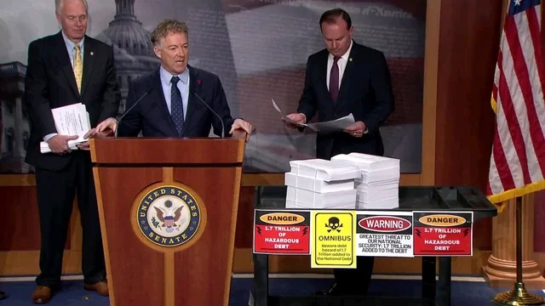
“I brought along the 1.7 trillion, 4,000+ page Pelosi-Schumer omnibus spending bill that's being fast-tracked through the Senate. This process stinks. It's an abomination. It's a no good rotten way to run government. We're standing up and saying NO.” -Senator Rand Paul

Slide 3
H.R. 133 - Consolidated Appropriations Act, 2021
5,593 pages, 6779344 characters, the longest bill ever passed by Congress
$900 billion in stimulus relief for the COVID-19 pandemic
$1.4 trillion omnibus spending bill for the 2021 federal fiscal year
Threatened government shutdown

Slide 4
Strategy for H.R. 133 text
Fine-tune T5 ("Text-to-Text Transfer Transformer.") to dataset of government bills and summaries to produce automated summarizer of legal text
Split H.R. 133 into component parts, summarize parts
Display summaries side-by-side with original text to increase ease of reading while maintaining full context

Slide 5
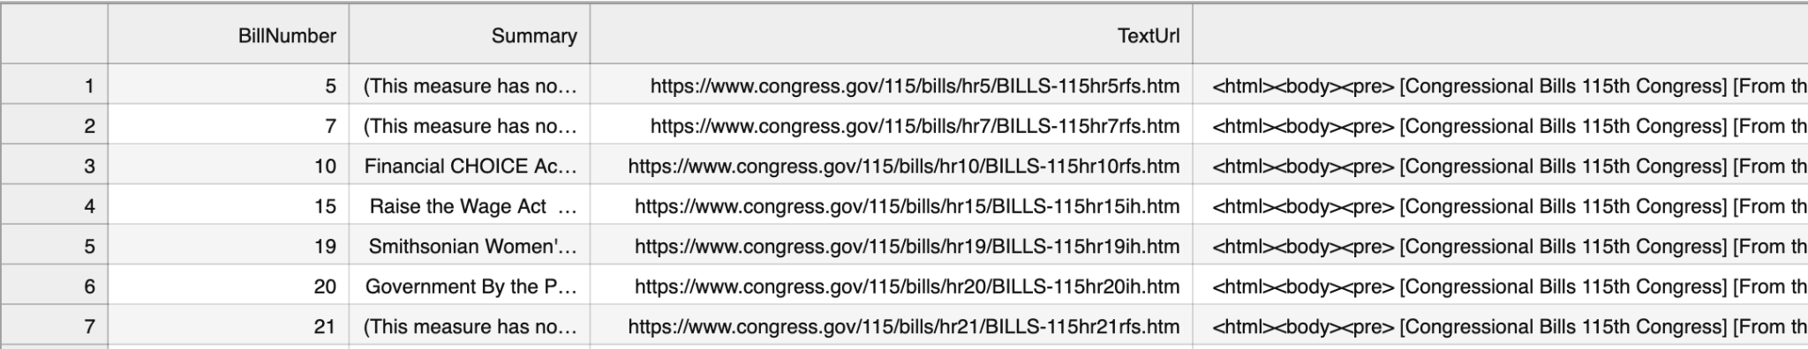
Data Set: House Resolutions of 115th Congress
1)Summaries from
@uscongress
Data.world
3)Scraping text
with BeautifulSoup
2)URL of bill text from
Congress.gov API

Slide 6
Source summary/ simpleT5 generated summary:
H.R. 1854
Full text 7239 characters, ~3-4 pages
Published Summary:
“Prescription Drug Monitoring Act of 2017: This bill requires a state that receives grant funds under the prescription drug monitoring program (PDMP) or the controlled substance monitoring program to comply with specified requirements, including a requirement to share its PDMP data with other states. The Department of Justice (DOJ) or Department of Health and Human Services may withhold grant funds from a state that fails to comply.To facilitate data sharing among states, the bill directs DOJ to award a grant under the Comprehensive Opioid Abuse Grant Program to establish and maintain a data-sharing hub.”
Generated Summary:
“Prescription Drug Monitoring Act of 2017 This bill amends the Public Health Service Act to require the Department of Health and Human Services (HHS) to establish and maintain an inter-state data-sharing single hub to facilitate the sharing of PDMP data among states and to ensure that the data is available for public and private use. The bill also directs HHS, in coordination with other federal agencies, to: (1) provide information on the health care system; ( . ;; .' ( - " " " " ( " ( n den " ""- " " "" " "n ( (n- s, " ' "s ". " -- " "”

Slide 7
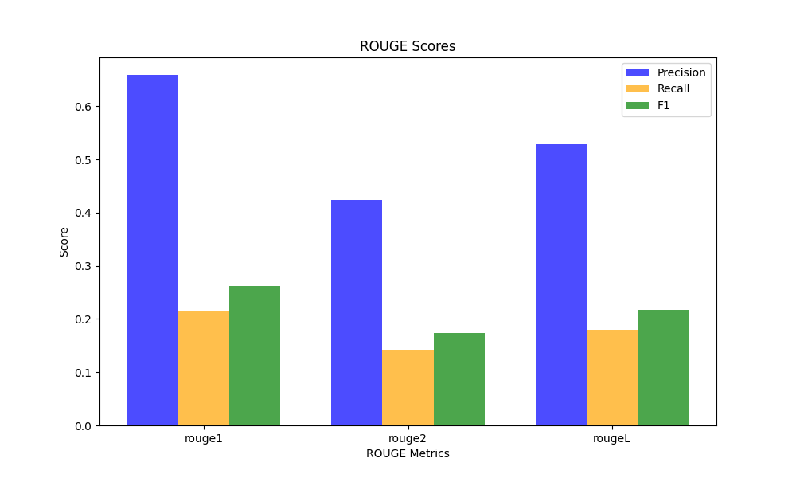
Model Evaluation with ROGUE
“ROUGE (Recall-Oriented Understudy for Gisting Evaluation): ROUGE measures the overlap between the model-generated summary and the reference summary in terms of n-grams (word sequences).”
ROUGE-1 overlapping unigrams
ROUGE-2 overlapping bigrams
ROUGE-L longest common subsequence (LCS)

Slide 8
Structure of Large Bills
Full Bill Text
Division A
Division B
Division C
Division FF
Title I
Title I
Title II
Title II
Title III
Section 101
Section 102

Slide 9
Splitting H.R. 133 with regular expressions
Divisions being with “DIVISION” followed by letter of alphabet, then double letters once reach 27 division ie 'DIVISION [A-Z]{1,2}'
Titles begin with “TITLE” then roman numerals, highest count was 21, used 'TITLE [IVX]+\b'
Sections begin “Sec.” followed by integer with another period ie “Sec. 101.”

Slide 10
Application of simpleT5 summarizer to split text of H.R. 133
Two Problems:
Self-references within bill prevention splitting by section
Processing time, full bill would take ~25 hrs.
Solutions:
Split to Title level, break text into sections for summarizer, append summaries together
Run on 3 Divisions

Slide 11
Dashboard sample findings:
Division M Title II: “ For an additional amount for ``Public Health and Social Services Emergency Fund'', $22,400,000,000, to remain available until September 30, 2022, to prevent, prepare for, and respond to coronavirus, domestically or internationally, which shall be for necessary expenses for testing, contact tracing, surveillance, containment, and mitigation”
”
Division C Title IX: ”No funds made available by this Act may be made available for any member of the Taliban except to support a reconciliation activity that includes the participation of members of the Government of Afghanistan and does not restrict the participation of women”

Slide 12
Opportunities and challenges
Overall process adaptable to any long, highly formatted text: contracts, insurance policies, etc
Text splitting at Section level would provide much greater ability to quickly scan source text context
Processing time presented a difficulty for this project, having dedicated computing power rather than Google Colab may address this

